Slide 1

Alpine: New User Seminar

Slide 2
CURC Alpine: New User Seminar
Instructor:
Website: www.rc.colorado.edu
Helpdesk: rc-help@colorado.edu
Slides: https://github.com/ResearchComputing/New_User_Seminar
Survey: http://tinyurl.com/curc-survey18

Slide 3

RMACC Cyber Infrastructure Portal
https://ask.cyberinfrastructure.org/c/rmacc/65
This forum provides opportunity for RMACC members to converse amongst themselves and with the larger, global research computing community.
The “go to” general Q&A platform for the global research computing community - researchers, facilitators, research software engineers, CI engineers, sys admins and others.

Slide 4
Account Check
Does anyone not have a CU Research Computing account who would like to use a temporary account*?
*only available during seminar

Slide 5
Learning Goals
What is CU Research Computing (CURC)?
Understand Basic CURC Resources & the Alpine cluster
Getting an account & logging in
Navigate the RC system
Running a job
Help!

Slide 6

Things to take note of:
Confusing, ambiguous, highly nuanced concepts
Our goal is to help you avoid common mistakes, pitfalls, and frustrations
Ask Questions!

Slide 7
What is CU Research Computing?

Slide 8



What is CU Research Computing?
Large-scale, beyond-the-desktop computing resources for the University of Colorado and more!

Slide 9


Resources Include:
High Performance Computing (HPC)
Storage of Research Data
High-Speed Data Transfer
Data Sharing
Cloud Computing
Training and Education

Slide 10
Primarily known for:
High Performance Computing (HPC)

Slide 11

High Performance Computing (HPC)
vs. Traditional Computing
Traditional computing generally has access to a single processor (perhaps multiple cores)

Slide 12
High Performance Computing (HPC)
vs. Traditional Computing
HPC is a network (or cluster) of hardware we call “nodes” linked together with high-speed interconnects

Slide 13

High Performance Computing (HPC)
vs. Traditional Computing
HPC is a multiprocessor environment that allows users to run jobs on several processors at once (also called parallel processing).

Slide 14
What can I use HPC for?
Solving large problems that require more:
Memory than you have on your PC
cores/nodes/power thank you have on your PC
Jobs that require hardware you may not have:
High Performance GPU computing
Specific Operating System
Visualization rendering

Slide 15


Puzzle Analogy
Working on a puzzle by yourself (although enjoyable!) will take time, even if you’re fast!

Slide 16
Puzzle Analogy
You can speed it up by inviting friends over and enticing them with food!
What happens if there are too many people?

Slide 17
What can I use HPC for?
Jobs that would take a long time on local machines can instead be distributed over hardware:
Parallelized to split up then joined (if software enabled)
Broken up into many serial jobs
BIG Job
Results
Tiny Job
Tiny Job
Results
Tiny Job

Slide 18
Research Computing Resources

Slide 19
HPC Cluster: Alpine
Alpine is the 3rd-generation HPC cluster at CURC, following:
Janus
RMACC Summit
Alpine is a heterogeneous cluster with hardware currently provided by CU Boulder
Access currently limited to CU Boulder users
Additional contributions provided from Colorado State University and Anschutz Medical Campus are planned for the near future
Alpine

Slide 20
HPC Cluster: Alpine
Hardware on Alpine will be purchased and released in stages:
Alpine (stage 1):
64 General CPU Nodes
AMD Milan, 64 Core, 3.74G RAM/Core
8 NVIDIA GPU Nodes
3x NVIDIA A100 (atop General CPU node)
8 AMD GPU Nodes
3x AMD MI100 (atop General CPU node)
Alpine

Slide 21
HPC Cluster: Alpine
Interconnect
CPU nodes: HDR-100 InfiniBand (200Gb inter-node fabric)
GPU nodes: 2x25 Gb Ethernet +RoCE
Scratch Storage: 25Gb Ethernet +RoCE
Operating System
RedHat Enterprise Linux version 8 operating system
Alpine

Slide 22
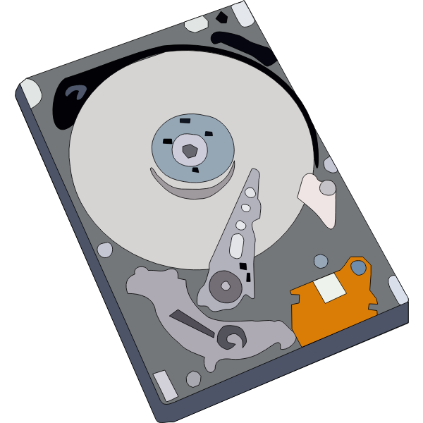

Storage at CURC
PetaLibrary
Local or Cloud
Core
Included with RC account
/home
/projects
scratch space
You can download your data locally or to a variety of other cloud resources
Paid Service for:
Storage
Archive
Sharing of research data

Slide 23
Data Sharing: Within RC
Sharing workspaces
Project space
Scratch Space
PetaLibrary Space*
*If you have purchased PetaLibrary space

Slide 24
Data Sharing: Outside RC
Globus (recommended):
GUI Web Application
Automates large transfers
Resumes failed transfers
Distributes large transfers across DTNs
Endpoints that can shared
Data Transfer Nodes (DTN)
Internal CU network needed
Command line tools
scp, sftp, rsync, rclone

Slide 25
Accessing Research Computing

Slide 26
How to Access RC Resources?
Get an RC account
Set up two-factor authentication with Duo
(Inform us of any specific needs)
Log in
Create greatness! (responsibly)

Slide 27
Getting an RC Account
University of Colorado, Boulder users and affiliates:
Request an account through the RC Account request portal
https://rcamp.rc.colorado.edu/accounts/account-request/create/organization
Colorado State University users:
Request an CSU eID if you don’t have one
Fill out account application form
Duo authentication
Then get an RC user account
https://www.acns.colostate.edu/hpc/summit-get-started/
RMACC Users:
Contact your local representative, if known. Email rc-help@colorado.edu
We’ll guide you through the process

Slide 28
Demo: Getting an Account
CU Boulder users and affiliates:
Request an account through the RC Account request portal
https://rcamp.rc.colorado.edu/accounts/account-request/create/organization

Slide 29
Your RC Account
Access to:
Alpine Cluster (also Summit)
Core Storage
PetaLibary Storage*
Gateways (CU Affiliates)
*If purchased

Slide 30
Two Factor Authentication (Duo)
Provides an extra level of authentication
We are outside the firewall!
Valuable resources
Inviting, high-profile target
Lost time investigating/fixing
Duo
You will receive a Duo invitation when your RC account is created

Slide 31
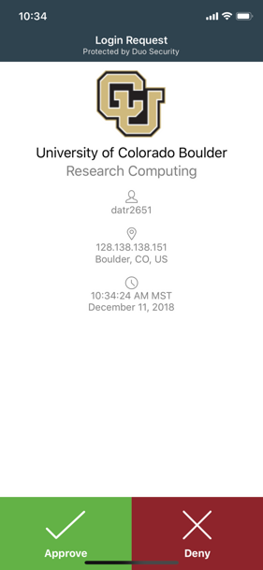
Duo Authentication
Duo smartphone app (recommended)
Phone Call/Text is an alternatives
Physical code generator “token” available for $20

Slide 32
Linux comfort level check
On a scale from (1-10) how familiar/comfortable are you with Linux?
The command line
Basic commands
Linux filesystem
Navigating the filesystem

Slide 33
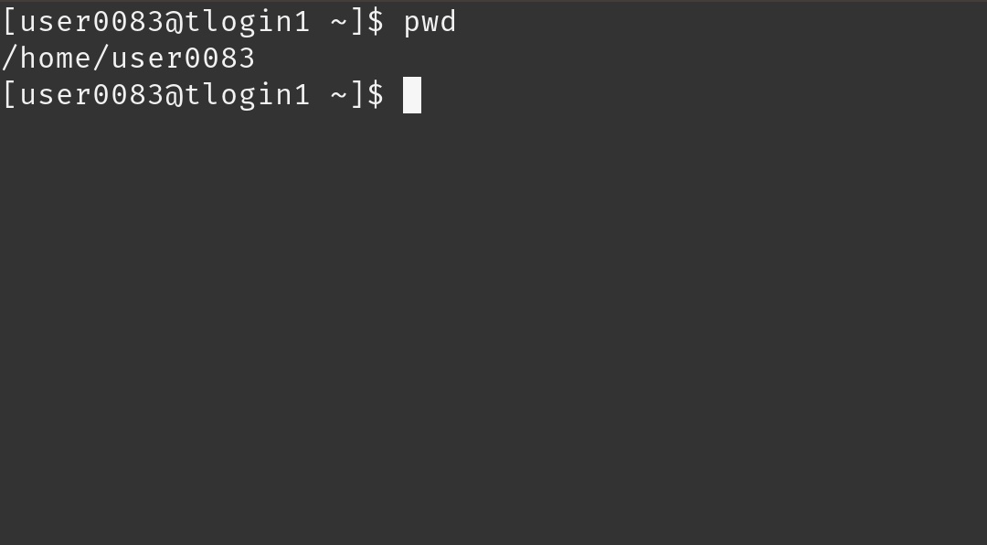
Terminal
Mac or Linux
Terminal application
Windows
PuTTY (recommended)
Powershell
Open OnDemand (alternative for CU affiliates)
For those less familiar with Linux (ondemand.rc.colorado.edu/)

Slide 34
Demo: Logging in via Terminal
To login to an RC login node:
$ ssh <username>@login.rc.colorado.edu
Supply your IdentiKey password and your Duo app will alert you to confirm the login
If you’re using a tutorial account (we provide password):
$ ssh <tutorial_user>@tlogin1.rc.colorado.edu

Slide 35
Demo: logging in with OnDemand
CURC Open OnDemand is a browser based, integrated, single access point for all of your HPC resources at CU Research Computing.
Visit https://ondemand.rc.colorado.edu.
CU Boulder only at the moment

Slide 36
Logging In
It’s important to note that you are NOT logging into any specific resource, Alpine, Summit, etc.
When you log in, you land on our login nodes
From there, you can access our other resources:
Alpine
Summit
Blanca

Slide 37
Navigating Research Computing

Slide 38
Node | File System
One computing server Physical hardware Work together in parallel | The basic tree-like layout From most nodes* you have access to most file systems
/
d1
d2
d3
d4
f1
f2

Slide 39
Node | File System
One computing server Physical hardware Work together in parallel | The basic tree-like layout From most nodes* you have access to most file systems
/
d1
d2
d3
d4
f1
f2

Slide 40
Node Types
Login | Compile | Compute
Where you log in to For editing code, job submission No heavy computation | Where you compile code, install packages Explore the Summit software environment Edit code, submit jobs No heavy computation | Where scheduled jobs run Intended for heavy computation
Ex. edit job script | Ex. Install python libs | Ex. Running Matlab

Slide 41
Alpine Compile Nodes
If you have used Summit in the past, compile nodes work slightly differently:
Instead of having dedicated hardware (2 nodes) which are oversubscribed for users to ssh into
Alpine’s acompile command starts an interactive job which users can compile in which provides the following benefits:
Users can request specific resources (i.e. more cores to compile with)
Limits dedicated hardware set aside
Can’t accidentally run full workflows

Slide 42
Alpine Compile Nodes
$ module load slurm/alpine
$ acompile
starts a job with default: 1 core, 3.74GB RAM, for 60 minutes*
$ acompile --help
--time=<time-limit> # set minimum runtime
--ntasks=<number-of-cores> # default 1, max 4
--gpu=<nvidia|amdgpu> # request gpu to compile with
--x11 # enable graphical forwarding
*only a single acompile job can be open at a time

Slide 43
Demo: Exploring Nodes
Once logged in, type:
$ acompile
To log in to an Alpine compile (or head) node.
Once on a compile node, type:
$ module avail
To list currently available software

Slide 44
Filesystem Structure
/home (2GB) | /projects (250GB) | Scratch (10TB)
Scripts, Code, Small, important files/directories Not for sharing files or job output | Code/files/libraries Software you are installing Sharing files Not for job output | Output from running jobs Large files/datasets Sharing files Cluster specific Not for long term storage
Ex .bashrc | Ex. Shared job scripts | Ex. Data

Slide 45
Demo: Exploring the Filesystem
Once logged in use the following commands to navigate to your different workspaces
$ cd /home/<user>
$ cd /projects/<user>
$ cd /scratch/alpine/<user>

Slide 46
Using RC Resources
We have:
Logged in
Explored nodes
Explored filesystem
How do we actually use the computing resources?

Slide 47
Running a Job

Slide 48
Jobs
What is a “job”?
Work for the cluster to perform on
Has a unique ID
Batch jobs
Submit job script which will be executed when resources are available
Create script containing information about the job
Submit the job file to a queue
Interactive jobs
Work interactively at the command line of a compute node

Slide 49
Job Scheduling
CURC Clusters are shared resources, jobs are:
Submitted to a queue
When the required resources become available, the scheduler determines which set of nodes to use
Executes your job
Computer
Hardware
Submit Job
Management
service
Get Results
Storage

Slide 50
SLURM
Simple Linux Utility for Resource Management
Through SLURM users can:
Schedule jobs on specific compute resources
Run jobs interactively or hands off
Query job statistics

Slide 51
Your first job
/home/<user>
Where to write it?
How to write it?
How to run it?
/projects/<user>
Scratch space
Notes:
demo

Slide 52
Job Script: 3 main parts
Directives
Specify resource requirements
Software
Because jobs run on a different node than from where you submitted…
…software that is needed must be loaded via the job script
User scripting
the actual user scripting that will execute when the job runs
#!/bin/bash
## Directives
#SBATCH --<resource>=<amount>
## Software
module purge
## User Scripting
hostname # example bash command

Slide 53
Slurm Options (directives)
#SBATCH <options> sbatch <options>
Allocation: --account=<account_no>
Partition: --partition=<partition_name>
Sending emails: --mail-type=<type>
Output file: --output=<file name> (%j gives you job id)
Number of nodes: --nodes=<nodes>
Number of tasks: --ntasks=<processes>
Quality of service: --qos=<qos>
Reservation: --reservation=<name>
Wall time: --time=<wall time>
Job Name: --job-name=<jobname> ...etc...
FYI: You do NOT actually type <> above – this designates something specific you as a user must enter about your job

Slide 54
Slurm Options (directives)
There are MANY slurm directives, most of which are not required
See all options at http://slurm.schedmd.com/sbatch.html
We will focus on some common options:
Partition: Nodes with the same hardware configuration
Wall time: Max time your job will run for
Node count: # of nodes requested
Core count: # of cores requested
Output file: name of output file

Slide 55
Alpine Partitions
Partition | Description | # of nodes | RAM/core (GB) | cores/node | GPUs/node
amilan-<institution> | General Compute Node: AMD Milan | 64 | 3.74 | 64 | 0
ami100-<institution> | GPU Node: 3x AMD MI100 | 8 | 3.74 | 64 | 3
aa100-<institution> | GPU Node: 3x Nvidia A100 | 8 | 3.74 | 64 | 3
Institutions:
ucb: University of Colorado, Boulder
csu: Colorado State University
amc: Anschutz Medical Campus

Slide 56
Demo: Writing a simple job hostname.sh
Submit a slurm job with the following instructions:
The job will be submitted from a bash script named hostname.sh
The job will run on 1 node
We will request 1 minute of wall time
Run on the amilan-ucb partition
Output should contain job id
The job should run the Unix “hostname” command

Slide 57
Demo: Writing a simple job (hostname)
Set up batch job boilerplate
Using text editor (vim or nano), create a file called hostname.sh with the following text:
#!/bin/bash
## Directives
#SBATCH --<resource>=<amount>
## Software
module purge
## User Scripting

Slide 58
Demo: Writing a simple job (hostname)
Directives:
1 node
1 minute wall time
“amilan-ucb” partition
Output should contain job id
Number of nodes:
--nodes=<nodes>
Wall time:
--time=<wall time>
Partition:
--partition=<partition_name>
Output file:
--output=<file name>
(%j gives you job id)

Slide 59
Demo: Writing a simple job (hostname)
Software:
Do we need any software? (modules)
User script:
What command do we want to run?

Slide 60
Demo: Writing a simple job (hostname)
#!/bin/bash
#SBATCH --nodes=1 # Number of requested nodes
#SBATCH --time=0:01:00 # Max wall time
#SBATCH --partition=amilan-ucb # Specify Summit haswell nodes
#SBATCH --output=hostname_%j.out # Rename standard output file
# purge all existing modules
module purge
hostname

Slide 61
Submitting a Job
Load up the slurm Alpine module (default is still Summit)
$ module load slurm/alpine
Submit the job:
$ sbatch <script-name>.sh
Check output
$ cat <output-name>.out

Slide 62
Review: Learning Goals
What is CU Research Computing (CURC)?
Understand Basic Resources (Alpine cluster)
Getting an account & logging in
Navigate the RC system
Running a job
Help!

Slide 63
Help! I’m stuck, where do I go?
Documentation: curc.readthedocs.io/
Trainings with Center for Research Data and Digital Scholarship (CRDDS): https://www.colorado.edu/crdds/
Helpdesk: rc-help@colorado.edu

Slide 64
Questions

Slide 65
Survey and feedback
http://tinyurl.com/curc-survey18

